Slide 1
19CSE202 Database Management Systems
Introductions

Slide 2
Contents
Part I
Introduction
Purpose of Database system
View of data
Part II
Data Models
Database languages
Database design
Database Engine
Database and application architecture
Database users and administrators

Slide 3
Chapter 1
Part I

Slide 4
Contents
Introduction
Purpose of Database system
View of data

Slide 5
Introduction
A Database Management System (DBMS) is a
collection of interrelated data and
a set of programs to access those data.
The primary goal of a DBMS is to provide a way to store and retrieve database information that is both convenient and efficient
Management of data involves both
Defining structures for storage of information and
Providing mechanisms for the manipulation of information

Slide 6
Contents
Introduction
Purpose of Database system
View of data

Slide 7
Purpose of Database Systems
This typical file-processing system is supported by a conventional operating system.
Disadvantages of this typical file processing system are:
Data redundancy and inconsistency
Difficulty in accessing data
Data isolation
Integrity problems
Atomicity problems
Concurrent-access anomalies
Security problems

Slide 8
Purpose of Database Systems
Disadvantages of this typical file processing system are:
Data redundancy and inconsistency
The programs may be written in several programming languages.
The same information may be duplicated in several places or files-Redundancy
For example , the address and telephone number of a particular customer may appear in a file that consists of savings-account records and in a file that consists of checking-account records.
The redundancy of data leads to higher storage and access cost.
The various copies of the same data may no longer agree- Inconsistency
For example , a changed customer address may be reflected in savings-account records but not elsewhere in the system.

Slide 9
Purpose of Database Systems
Disadvantages of this typical file processing system are:
Difficulty in accessing data
The conventional file-processing environments do not allow needed data to be retrieved in a convenient and efficient manner. More responsive data-retrieval systems are required for general use and need to write a new program to carry out each new task
– Example Suppose that one of the bank officers needs to find out the names of all customers who live within a particular postal-code area. The officer asks the data-processing department to generate such a list. Because the designers of the original system did not anticipate this request, there is no application program on hand to meet it.
Data isolation
Because data are scattered in various files, and files may be in different formats, writing new application programs to retrieve the appropriate data is difficult.

Slide 10
Purpose of Database Systems
Disadvantages of this typical file processing system are:
Integrity problems
The data values stored in the database must satisfy certain types of consistency constraints.
Hard to add new constraints or change existing ones
– Example - The balance of a bank account may never fall below a prescribed amount (say, $25).
Atomicity problems
Failures may leave database in an inconsistent state with partial updates carried out
Example: Transfer of funds from one account to another should either complete or not happen at all

Slide 11
Purpose of Database Systems
Disadvantages of this typical file processing system are:
Concurrent-access anomalies
Concurrent access needed for performance
Uncontrolled concurrent accesses can lead to inconsistencies
Example: Two people reading a balance (say 100) and updating it by withdrawing money (say
50 each) at the same time
Security problems
Hard to provide user access to some, but not all, data
Example- in a banking system, payroll personnel need to see only that part of the database that has information about the various bank employees. They do not need access to information about the various bank employees.

Slide 12
Contents
Introduction
Purpose of Database system
View of data

Slide 13
View of Data
Levels of Abstraction
Physical level: The lowest level of abstraction describes how the data are actually stored.
Logical level: It describes what data are stored in the database, and what relationships exist among those data.
View level: application programs hide details of data types.
information (such as an employee’s salary) for security purposes.
For example
type instructor = record
instructor_id : char(5);
instructor_name : char(20);
instructor_deptname : char(20);
instructor -salary : numeric(8,2);
end;
Views can also hide

Slide 14
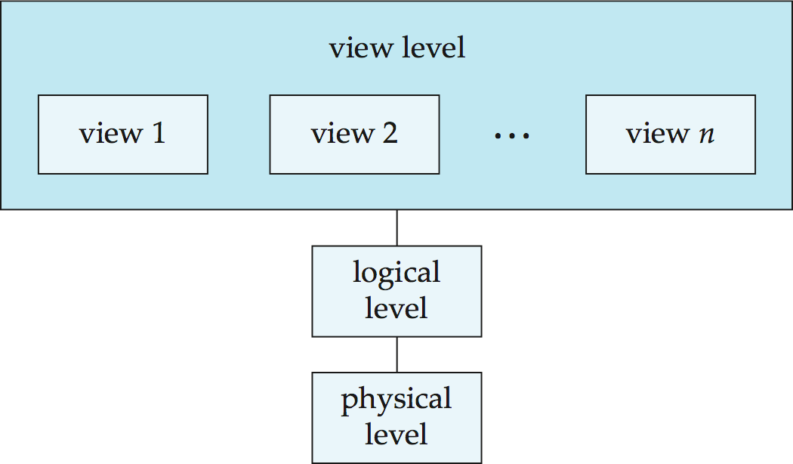
View of Data
Levels of Abstraction

Slide 15
View of Data
Instances and Scheme
Schema: The overall design of the database is called the database schema. A database schema corresponds to the variable declarations in a program.
(1) Physical Schema: The physical schema describes the database design at the physical level.
(2) Logical Schema: The logical schema describes the database design at the logical level. It is analogous to type information of a variable in a program
Example: The database consists of information about a set of customers and accounts in a bank and the relationship between them
Instance: The collection of information stored in the database at a particular moment is called an instance of the database. The values of the variables in a program at a point in time correspond to an instance of a database schema.

Slide 16


Schema
Instance

Slide 17
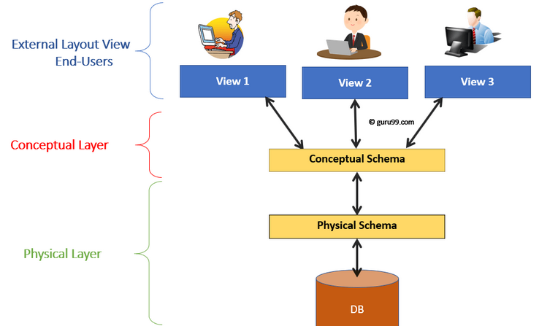
View of Data
Data Independence
Physical Data Independence: The ability to modify the physical schema without changing the logical schema
Eg:
Using a new storage device like Hard Drive or Magnetic Tapes
Modifying the file organization technique in the Database
Logic Data Independence: The ability to modify the logical schemas without changing the external views.
Eg.
Add/Modify/Delete a new attribute, entity or relationship is possible without a rewrite of existing application programs
Merging two records into one

Slide 18
Chapter 1
Part II

Slide 19
Contents
Data Models
Database languages
Database design
Database Engine
Database and application architecture
Database users and administrators

Slide 20
Data Models
A data model is a collection of conceptual tools for describing
data,
data relationships,
data semantics, and
consistency constraints
Different Data Models
Relational Model
Entity-Relationship Model
Object-Based Data Model
Semistructured Data Model
Network data model
Hierarchical data model

Slide 21
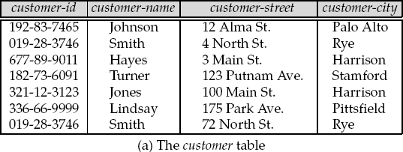
Data Models
Different Data Models
Relational Model
The relational model uses a collection of tables to represent both data and the relationships
among those data.
Each table has multiple columns, and each column has a unique name.
Tables are also known as relations.
Figure presents a sample relational database comprising one tables which show details of bank customers,

Slide 22
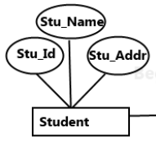
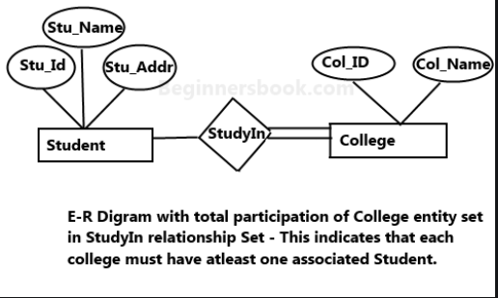
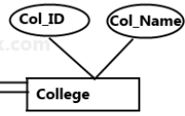
Data Models
Different Data Models
Entity-Relationship Model
The entity-relationship (E-R) data model uses a collection of basic objects, called entities, and relationships among these objects.
Entities are described in a database by a set of attributes.
A relationship is an association among several entities.
The set of all entities of the same type and the set of all relationships of the same type are termed an entity set and relationship set, respectively.

Slide 23
Data Models
Different Data Models
Object-Based Data Model
Object-oriented programming (especially in Java, C++, or C#) has become the dominant software-development methodology.
This led to the development of an object-oriented data model with notions of encapsulation, methods (functions), and object identity.
The object-relational data model combines features of the object-oriented data model and
relational data model.
Semistructured Data Model
The semistructured data model permits the specification of data where individual data items of the same type may have different sets of attributes.
The Extensible Markup Language (XML) is widely used to represent semistructured data.

Slide 24
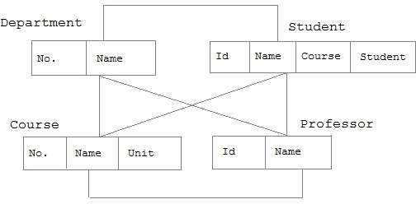
Data Models
Different Data Models
Network data model
Entities are organised in a graph, in which some entities can be accessed through several path

Slide 25
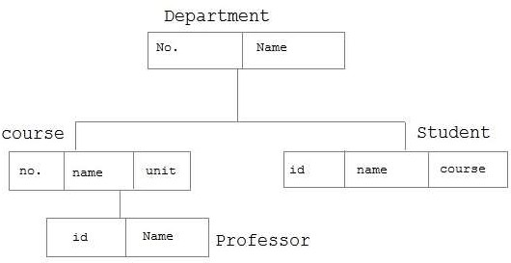
Data Models
Different Data Models
Hierarchical data model
Each entity has only one parent but can have several children .
At the top of hierarchy there is only one entity which is called Root.

Slide 26
Contents
Data Models
Database Languages
Database design
Database Engine
Database and application architecture
Database users and administrators

Slide 27
Database Languages
(1) Data-Definition Language:
Specification of a database schema by a set of definitions expressed by a special language is called a data-definition language (DDL).
Specification of the storage structure and access methods used by the database system by a set of statements in a special type of DDL is called a data storage and definition language.
(2) Data Manipulation Language
Commands to query information from database.
To insert, delete and modify rows.
(3) Data Control Language
Commands to set authorization.
To provide controlled access.
(4) Transaction Control Language
To manage transactions in the database.

Slide 28
Constraints
- A Constraint can be an arbitrary predicate pertaining to the database.
The data values stored in the database must satisfy certain consistency constraints.
(Eg, Account Balance can not be negative)
DDL allows us to specify such constraints…The database system checks this constraint every time when the data is updated.
The integrity constraints implemented by database systems are:
Domain Constraints
Referential Integrity
Assertions

Slide 29
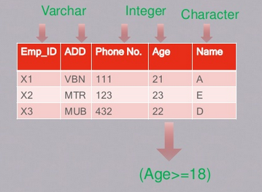
Data-Definition Language:
Integrity Constraints
Domain Constraints: A domain of possible values must be associated with every attribute (for example, integer types, character types, date/time types).

Slide 30
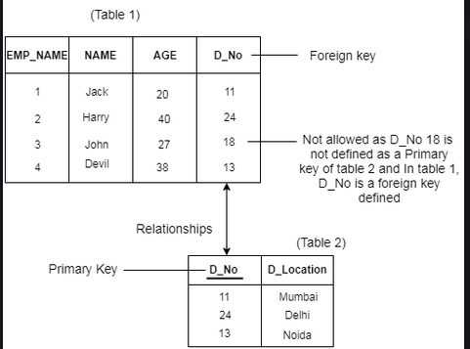
Data-Definition Language:
Integrity Constraints
Referential Integrity: There are cases where we wish to ensure that a value that appears in one relation for a given set of attributes also appears in a certain set of attributes in another relation (referential integrity).

Slide 31

Data-Definition Language:
Integrity Constraints
Assertion – an assertion is any condition that the database must always satisfy.
The domain constraint and referential integrity constraint are the special form of Assertions.
There many other conditions like these, and they can be expressed by them.
Eg. “Every department must have at least five courses offered every semester”

Slide 32
Database Languages
Data-Manipulation Language:
To access or manipulate data as organized by the appropriate data model.
The type of access are – insertion, retrieval, deletion and modification.
Two types
Procedural DMLs
To specify what data are needed and how to get those data.
Declarative DMLs
(non-procedural DMLs)
To specify what data are needed without specifying how to get those data.
Query – a statement requesting for retrieval of information.
Query Language – The portion of DML (We use SQL).
Query processor – a portion of database system, translate the queries into sequence of actions at the physical level.

Slide 33
Database Languages
Data-Control Language:
to control access to data stored in a database (Authorization)
Authorization: We may want to differentiate among the users as far as the type of access they are permitted on various data values in the database.
These differentiations are expressed in terms of authorization, the most common being:
Read authorization, which allows reading, but not modification, of data;
Insert authorization, which allows insertion of new data, but not modification of existing data;
Update authorization, which allows modification, but not deletion, of data; and
Delete authorization, which allows deletion of data.
We may assign the user all, none, or a combination of these types of authorization.
The output of DDL is placed in data dictionary which contains metadata-Data about data.
Data dictionary can be accessed only by database system. Database system consults the data dictionary before reading or modifying the actual data.

Slide 34
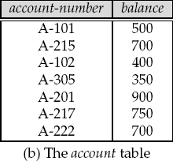
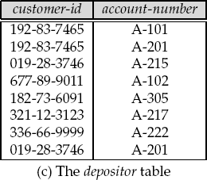
Relational Database
Table
Each table has multiple columns and each column has a unique name. Tables are also known as relations.
Figure presents a sample relational database comprising three tables: One show details of bank customers, the second shows accounts, and the third shows which accounts belong to which customers.

Slide 35
Relational Database
Data Definition Language
SQL provides a rich DDL that allows one to define tables, integrity constraints, assertions, etc.
Example 1: the following statement in the SQL language defines the account table:
create table account (account-number char(10), balance integer)
Execution of the above DDL statement creates the account table. In addition, it updates a special set of tables called the data dictionary or data directory. A data dictionary contains metadata—that is, data about data.

Slide 36
Relational Database
Data Manipulation Language
The SQL query language is nonprocedural. A query takes as input several tables (possibly only one) and always returns a single table.
Example 1: SQL language finds the name of the customer whose customer-id is 192-83-7465:
select customer.customer-name
from customer
where customer.customer-id = 192-83-7465
The query specifies that those rows from the table customer where the customer-id is 192-83- 7465 must be retrieved, and the customer-name attribute of these rows must be displayed. If the query were run on the table, the name Johnson would be displayed.

Slide 37
Relational Database
Data Manipulation Language
Queries may involve information from more than one table.
For instance, the following query finds the balance of all accounts owned by the customer with customer_id 192-83-7465.
select account.balance
from depositor, account
where depositor.customer-id = 192-83-7465 and
depositor.account-number = account.account-number
The system would find that the two accounts numbered A-101 and A-201 are owned by customer 192-83-7465 and would print out the balances of the two accounts, namely 500 and 900.

Slide 38
Relational Database
Database Access from Application Programs
There are two ways to do this:
By providing an application program interface (set of procedures) that can be used to send DML and DDL statements to the database and retrieve the results.
The Open Database Connectivity (ODBC) standard for use with the C language
The Java Database Connectivity (JDBC) standard for the Java language.
By extending the host language syntax to embed DML calls within the host language program. The DML precompiler, converts the DML statements to normal procedure calls in the host language.

Slide 39
Contents
Data Models
Database languages
Database design
Database Engine
Database and application architecture
Database users and administrators

Slide 40
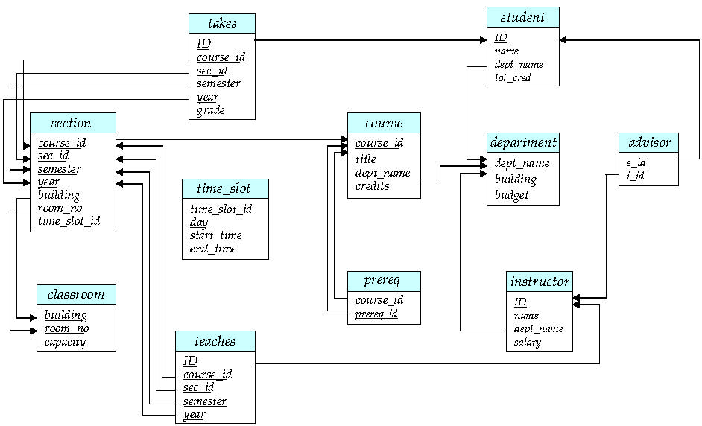
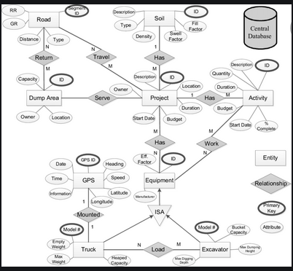
Database Design
Design Process
The initial phase of database design is to characterize fully the data needs of the prospective database users. The outcome of this phase is a specification of user requirements.
Next, the designer chooses a data model and, by applying the concepts of the chosen data model, translates these requirements into a conceptual schema of the database. The schema developed at this conceptual-design phase provides a detailed overview of the enterprise.

Slide 41
Database Design
Design Process
A fully developed conceptual schema also indicates the functional requirements of the enterprise. In a specification of functional requirements, users describe the kinds of operations (or transactions) that will be performed on the data. The designer can review the schema to ensure it meets functional requirements.
The process of moving from an abstract data model to the implementation of the database
proceeds in two final design phases.
Logical Design – Deciding on the database schema. Database design requires that we find a “good” collection of relation schemas.
Business decision – What attributes should we record in the database?
Computer Science decision – What relation schemas should we have and how should the attributes be distributed among the various relation schemas? (Data model & Algorithms) ( we will use ER model and Normalization)
Physical Design – Deciding on the physical layout of the database

Slide 42
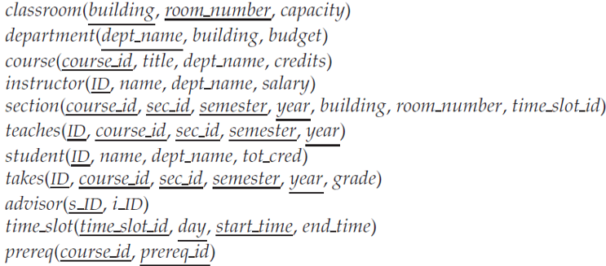
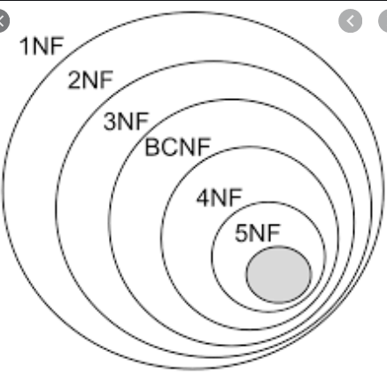
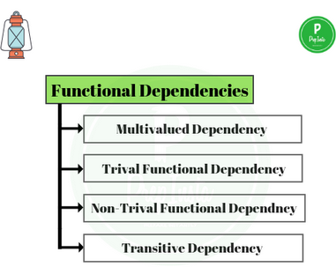
Normalization
Method for designing a relational database.
Goal: to generate set of relations schemas that allow us to store the data with out redundancy and to retrieve the data easily.
Approach: to design the schemas that are in normal form. (Rule)
To check the normal form we need additional information, such as functional dependency. (Conditions)

Slide 43
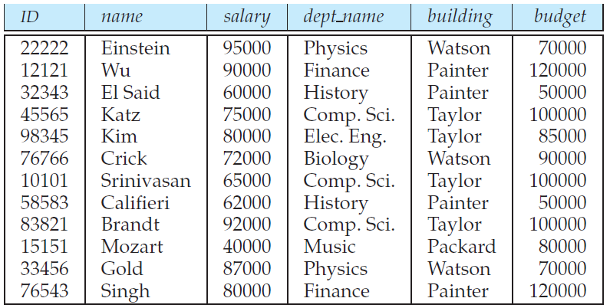
Normalization
Example to understand the need
Single relation combining Instructor and Department.
(1) Building information is repeating – Redundancy.
(2) To update budget of History department – to be done in multiple places.
(3) Can’t start a new department, without instructor information. (one solution: use of null)

Slide 44
Contents
Data Models
Database languages
Database design
Database Engine
Database and application architecture
Database users and administrators

Slide 45
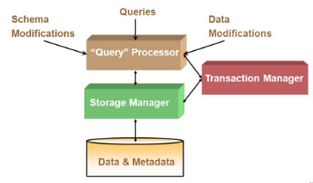
Database Engine
A database system is partitioned into modules that deal with different tasks.
Broadly divided in to
Storage Manager.
Query Processor.

Slide 46
Data Storage and Querying
Storage Manager
The storage manager is the component of a database system that provides the interface between the low-level data stored in the database and the application programs and queries submitted to the system.
The storage manager is responsible for
the interaction with the file manager.
for storing, retrieving, and updating data in the database.

Slide 47
Data Storage and Querying
Storage Manager
The storage manager components include:
Authorization and integrity manager: tests for the satisfaction of integrity constraints and
checks the authority of users to access data.
Transaction manager: ensures that the database remains in a consistent (correct) state despite system failures, and that concurrent transaction executions proceed without conflicting.
File manager: manages the allocation of space on disk storage and the data structures used to
represent information stored on disk.
Buffer manager: is responsible for fetching data from disk storage into main memory, and deciding what data to cache in main memory.

Slide 48
Data Storage and Querying
Storage Manager
The storage manager implements several data structures as part of the physical system implementation:
Data files: store the database itself.
Data dictionary: stores metadata about the structure of the database, in particular the schema of the database.
Indices: can provide fast access to data items. For example, we could use an index to find the
instructor record with a particular ID, or all instructor records with a particular name.
Hashing: is an alternative to indexing that is faster in some but not all cases.

Slide 49
Data Storage and Querying
The Query Processor
The query processor components include:
DDL interpreter: interprets DDL statements and records the definitions in the data dictionary.
DML compiler: translates DML statements in a query language into an evaluation plan consisting of low-level instructions that the query evaluation engine understands. The DML compiler performs query optimization.
Query evaluation engine: executes low-level instructions generated by the DML compiler.

Slide 50
Transaction Management
A transaction is a collection of operations that performs a single logical function in a database application. Each transaction a unit of both atomicity and consistency.
Transaction-management component ensures that the database remains in a consistent (correct) state despite system failures (e.g., power failures and operating system crashes) and transaction failures.
Concurrency-control manager controls the interaction among the concurrent
transactions, to ensure the consistency of the database.

Slide 51
Transaction Management
What if the system fails?
What if more than one user is concurrently updating the same data?
Consider the one account say A is debited and another account say B is credited.
The all-or-none requirement is called atomicity e.g. both the credit and debit occur, or that neither occurs.
In addition, it is essential that the execution of the funds transfer preserve the consistency of the database. That is, the value of the sum of the balances of A and B must be preserved. This correctness requirement is called consistency.
After the successful execution of a funds transfer, the new values of the balances of accounts A and B must persist, despite the possibility of system failure. This persistence requirement is called durability.

Slide 52
Contents
Data Models
Database languages
Database design
Database Engine
Database and application architecture
Database users and administrators

Slide 53
Database Architecture
The architecture of a database system is greatly influenced by the underlying computer system on which the database system runs.
Database systems can be
centralized,
client-server, where one server machine executes work on behalf of multiple client machines.
parallel computer architectures.
Distributed databases which span multiple geographically separated machines

Slide 54
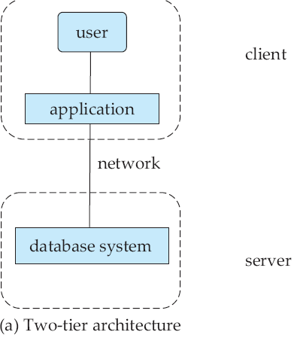
Database Architecture
In a two-tier architecture,
– the application resides at the client machine, where it invokes database system functionality at the server machine through query language statements.
– Application program interface standards like ODBC and JDBC are used for interaction between the client and the server.

Slide 55
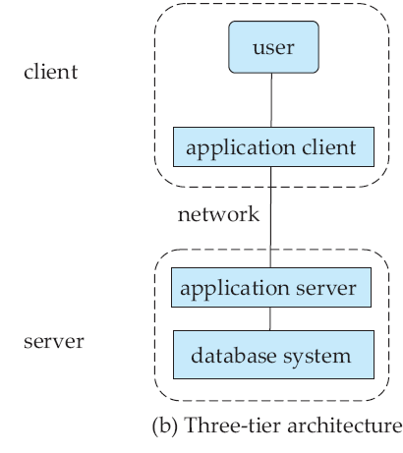
Database Architecture
In a three-tier architecture,
the client machine acts as merely a front end and does not contain any direct database
calls.
Instead, the client end communicates with an application server, usually through a forms interface.
The application server in turn communicates with a database system to access data.
The business logic of the application is embedded in the application server, instead of being distributed across multiple clients.

Slide 56
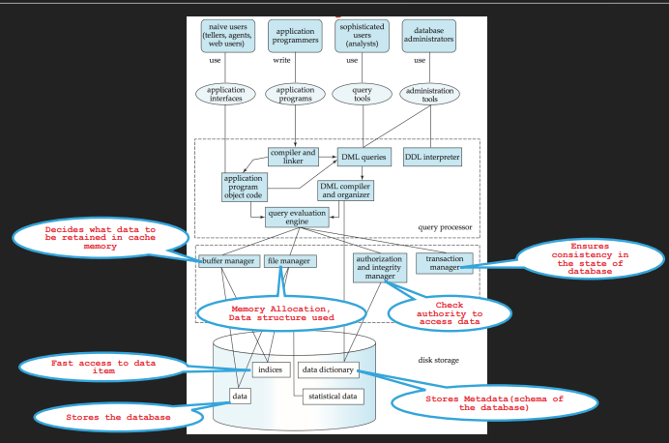

Slide 57
Contents
Data Models
Database languages
Database design
Database Engine
Database and application architecture
Database users and administrators

Slide 58
Database Users and Administrators
People who work with a database can be categorized as database users or database administrators.
Database Users and User Interfaces
Naive users
Application programmers
Sophisticated users
Specialized users

Slide 59
Database Users and Administrators
Database Users and User Interfaces
Naive users are unsophisticated users who interact with the system by invoking one of the application programs.
For example, a bank teller who needs to transfer $50 from account A to account B invokes a program called transfer. This program asks the teller for the amount of money to be transferred, the account from which the money is to be transferred and the account to which the money is to be transferred
Application programmers are computer professionals who write application programs. They can choose from many tools to develop user interfaces. Rapid application development (RAD) tools are tools that enable an application programmer to construct forms and reports with minimal programming effort.

Slide 60
Database Users and Administrators
Database Users and User Interfaces
Sophisticated users interact with the system without writing programs. they form their requests using a database query language. They submit each such query to query processor whose function is to break down DML statements into statements that the storage manager understands. Analysts who submit queries to explore data in the database fall in this category.
Specialized users are sophisticated users who write specialized database applications that do not fit into the traditional data-processing framework. Among these applications are computer-aided design systems, knowledgebase and expert systems, systems that store data with complex data types (for example, graphics data and audio data), and environment-modeling systems.

Slide 61
Database Users and Administrators
Database Administrator
A person who has central control of both data and program to access the data over the system is called a database administrator
The functions of a DBA include:
Schema definition: The DBA creates the original database schema by executing a set of data definition statements in the DDL.
Storage structure and access-method definition
Schema and physical-organization modification: The DBA carries out changes to the schema and physical organization to reflect the changing needs of the organization, or to alter the physical organization to improve performance.

Slide 62
Database Users and Administrators
Database Administrator
The functions of a DBA include:
Granting of authorization for data access: By granting different types of authorization, the database administrator can regulate which parts of the database various users can access. The authorization information is kept in a special system structure that the database system consults whenever someone attempts to access the data in the system.
Routine maintenance: Examples of the database administrator’s routine maintenance activities are:
Periodically backing up the database, either onto tapes or onto remote servers, to prevent loss of data in case of disasters such as flooding.
Ensuring that enough free disk space is available for normal operations, and upgrading disk space as required.
Monitoring jobs running on the database and ensuring that performance is not degraded by very expensive tasks submitted by some users.

Slide 63
Summary
Introduction
Purpose of Database system
View of data
Data Models
Database languages
Database design
Database Engine
Database and application architecture
Database users and administrators

Slide 64
Thank You
Happy to answer any questions ! ! !
Notes:
Not covering all.

Slide 65
Resources:
Text Book:
Silberschatz A Korth H F and SudharshanS , “Database System Concepts”, 6th Edition, TMH publishing company limited, 2011.
7th edition of text book is released in 2019 https://www.db-book.com/db7/index.html
6th edition Textbook Link https://www.db-book.com/db6/index.html
References:
Hector Garcia-Molina, Jeffrey D Ullman, JennierWidom, ‘Database System ; The complete book”, 2nd Edition, 2011.
Elmasri R and Navathe S B, “Fundamentals of Database Systems”, 5th Edition, Addison Wesley, 2006.
Ramakrishnan R and Gehrke J, “Database Management Systems”, 3rd Edition, TMH, 2003

